Slide 1


Phase 2 Project 7: SVM default model + All features Random Forest default mode + All features Tableau/Power BI dashboard
Team 7
Sandaru Welikala
Juan Maya
Mario Palomino

Slide 2
PHASE 2 ERROR ANALYSIS

Slide 3
Abstract
The goal of this project is to examine the errors made by machine learning models, focusing on understanding where and why misclassifications happen. We'll be working with data on patients admitted to the ICU due to heart-related issues.
The objective of the analysis is twofold: first, to predict the risk of death for these patients within 28 days of ICU admission, and second, to identify which features are most important in making these predictions.
After cleaning the data for MIMIC-IV, we have a tidy dataset from phase 1 with 34 features and 3406 observations. This cleaned data will serve as input for our models. Our plan is to evaluate the performance of Random Forest (RF) and Support Vector Machine (SVM) models.
Following model evaluation, we'll delve into the relationship between incorrect classifications and the actual ones. Our aim is to uncover patterns and differences in these classifications.
To compare the models:
We'll first run RF and SVM using all the features in our dataset.
Then, we'll pick out the most important features for each model using Pareto analysis and find the ones they have in common.
After finding the important features shared by both RF and SVM, we'll rerun the models using only these features. We'll call this set of features "MUST."
Steps used to uncover error patterns:
Identify wrong prediction cases
Extract relevant features
Error pattern analysis
Statistical tests
Visualization

Slide 4
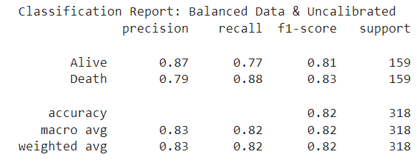
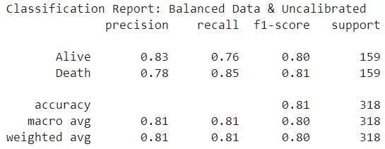
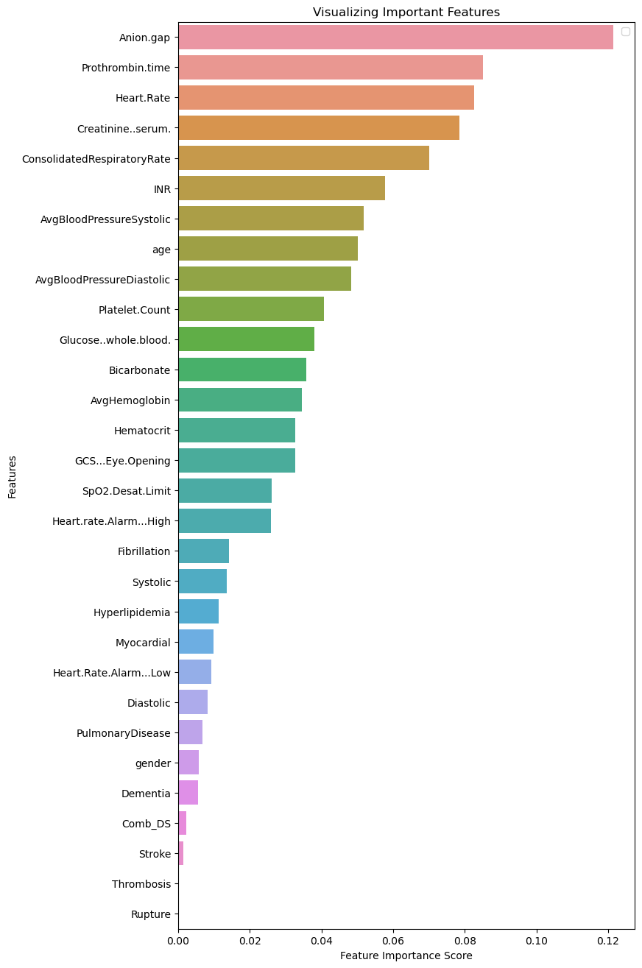
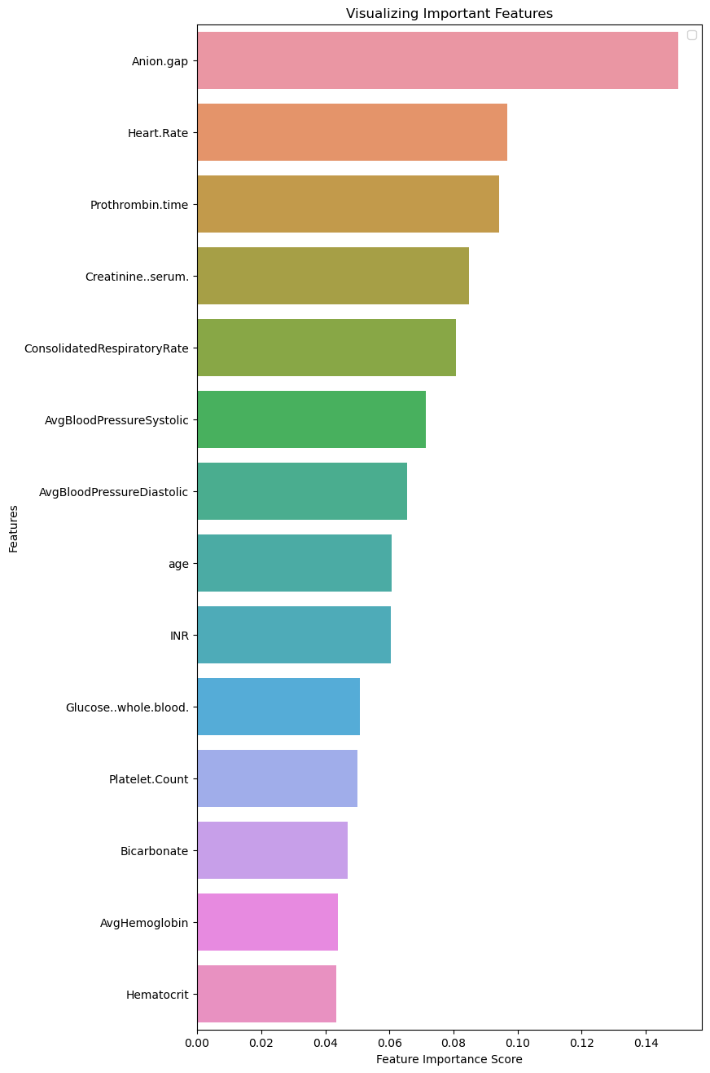
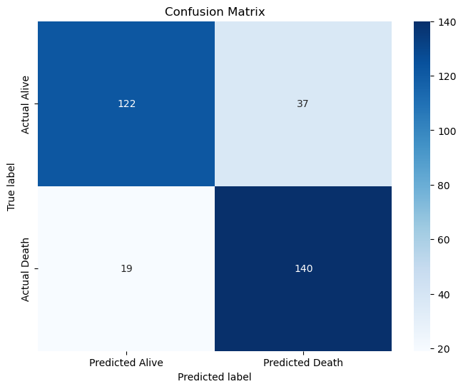

Section 2: Model Performance What is result of running same model with different features? Which are key variables for Random Forest?
ALL
34 Features
82% Accuracy
PARETO
14 Features
82% Weighted avg
82% Macro avg
81% Accuracy
80% Macro avg
80% Weighted avg
After running Random Forest with ALL features and with different features selecting key features with pareto law 20 variables were discarded and the loss of accuracy was 1%. The 1% impact is on predicting alive precision, but model still balance in all metrics.
Model behavior still good and loss of accuracy is low when selecting appropriate variables to remove.

Slide 5
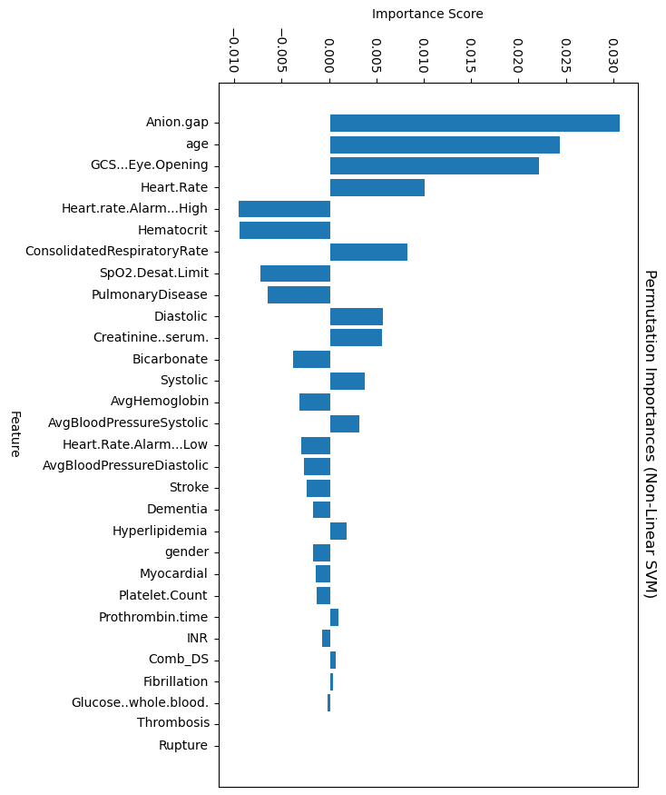
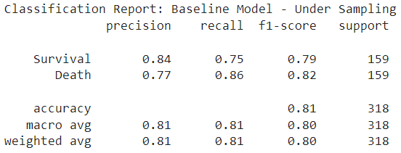
Section 2: Model Performance What is result of running 2 models with same features? Which are key variables for Random Forest?
RF
RF
14 Features Pareto
82% Accuracy
SVM
11 Features Pareto
82% Weighted avg
82% Macro avg
81% Accuracy
80% Macro avg
80% Weighted avg
VS
SVM needs 3 features less for pareto.
RF is 1% more precise.
RF is 2% more precise in macro avg
RF is 2% more precise in Weighted.
AUC 0.90
AUC 0.90
AUC is equal, 0.90.
SVM
Each model rate features in a different order and some of pareto features are in both models.
SVM accuracy is 1% better in macro and weighted avg. We notice that because sample is balance, as we can see in support, weighted is going to be same as macro.

Slide 6
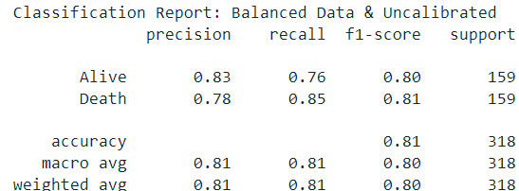
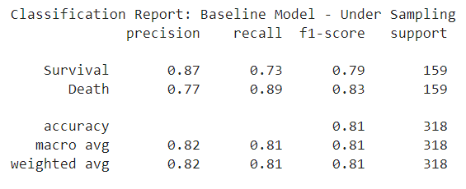
Section 3: Error analysis Which variables must be used for error analysis?
To analyze errors on different machine learning algorithms we will use statistical test and confusion matrix analysis as Ruuska (2018). To compare models under same circumstances we select variables that are common in pareto of importance of RF and SVM.
Which variables must be used for error analysis?
To select variables, we first identified the Pareto-important features for each model, RF and SVM. Then, selected the common features because any feature that is important in both models must be included as part of the features.
Random Forest (RF)
8 Features in common
ALL Features
Key Features
(Pareto Law)
14 Features
81% Accuracy
Support Vector Machine (SVM)
ALL Features
Key Features
(Pareto Law)
11 Features
81% Accuracy
Result is an 8 features list that is going to be used to algorithms and analyze errors.

Slide 7
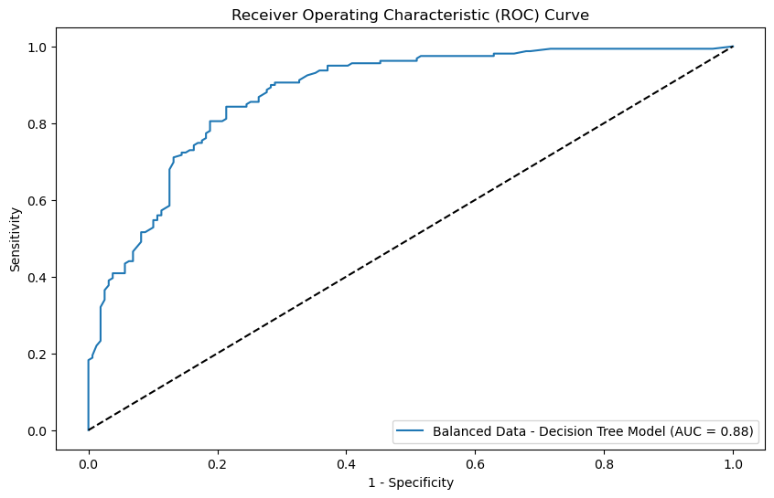
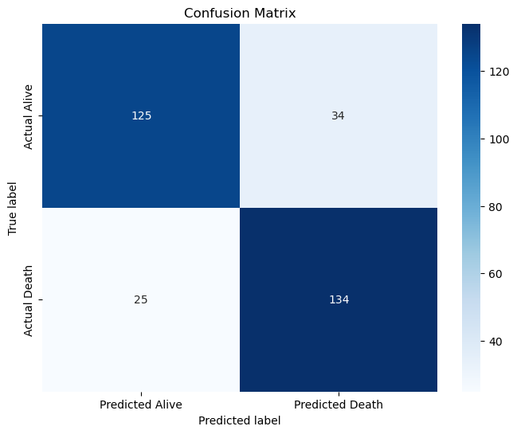
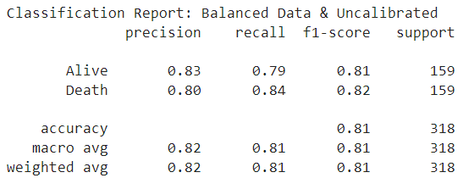
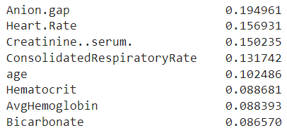
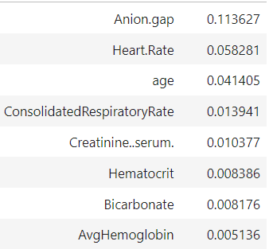
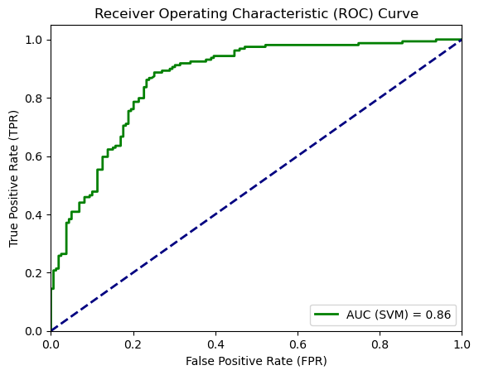

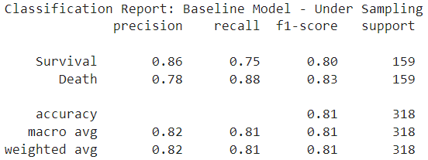
What is performance of models with 8 common features?
Comparison
Performance Metrics
RF
SVM
VS
Features Importance
Confusion Matrix
Features are in different order per model but,, Anion gap is 1st for both models.
Accuracy is 81% for both models.
Confusion matrix show a balance between classification with a good accuracy.
ROC/AUC
Both AUC are above 0.80 but, RF is better with 0.88.
Both models keep good performance with 8 features, accuracy is 81%, ML models did not lose much on performance metrics in comparison of running model with all features.
This 8 features are the ones that we are going to use in both models to do errors classification analysis.

Slide 8
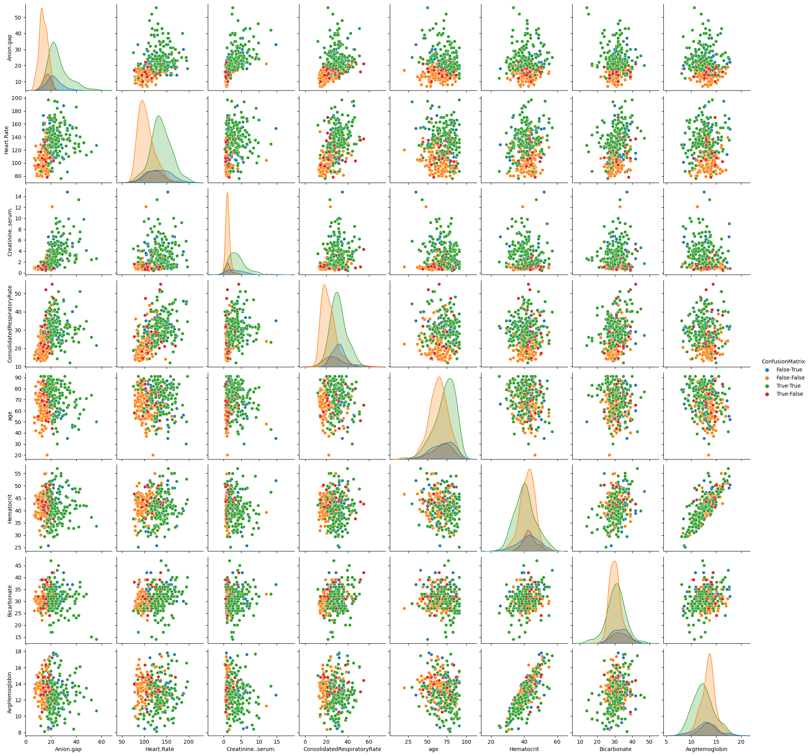
What's relation of errors with between variables?
To understand errors on prediction each observation was classified and plot against other variables.
Each color is near its similar observations, this means that correct classifications are alike and wrong predictions as well are alike.
As well, in diagonal of chart density distribution of variables.

Slide 9
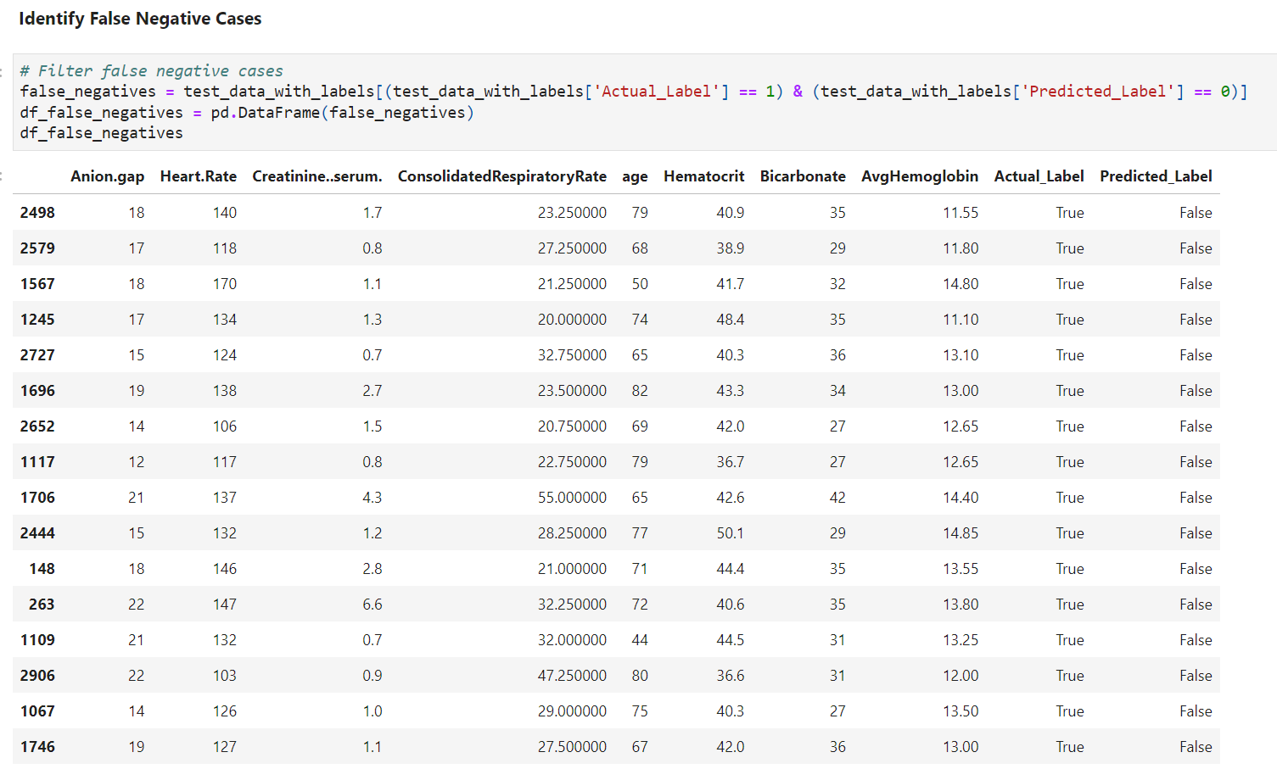
Statistical Test: What factors are generating errors?
To conduct the error analysis, we used most important 8 features filtered in section 2. We ran the both RF and SVM models using these 8 features were able to obtain following results on confusion matrix.
 | Random Forest | Support Vector Machine
True Negative (represents the number of cases where the model correctly predicted survival.) | 125 | 119
False Positive (represents the number of cases where the model incorrectly predicted death when the actual outcome was survival.) | 34 | 40
False Negative (represents the number of cases where the model incorrectly predicted survival when the actual outcome was death.) | 25 | 19
True Positive (represents the number of cases where the model correctly predicted death.) | 134 | 140
Steps used to uncover error patterns:
Identify wrong prediction cases
Extract relevant features
Error pattern analysis
Statistical tests
Visualization
For each prediction made by the both models, we did compare the predicted label with actual label and identify the cases where predicted label does not match actual label. These cases are,
False Negatives
False Positives

Slide 10
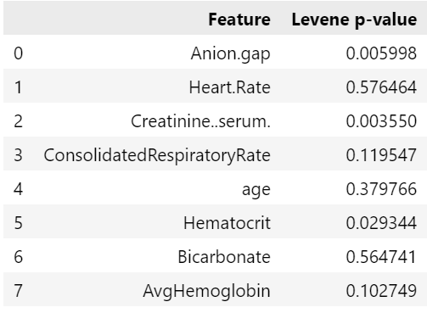
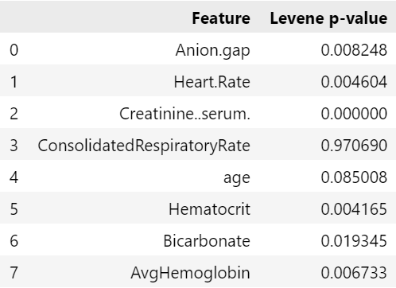
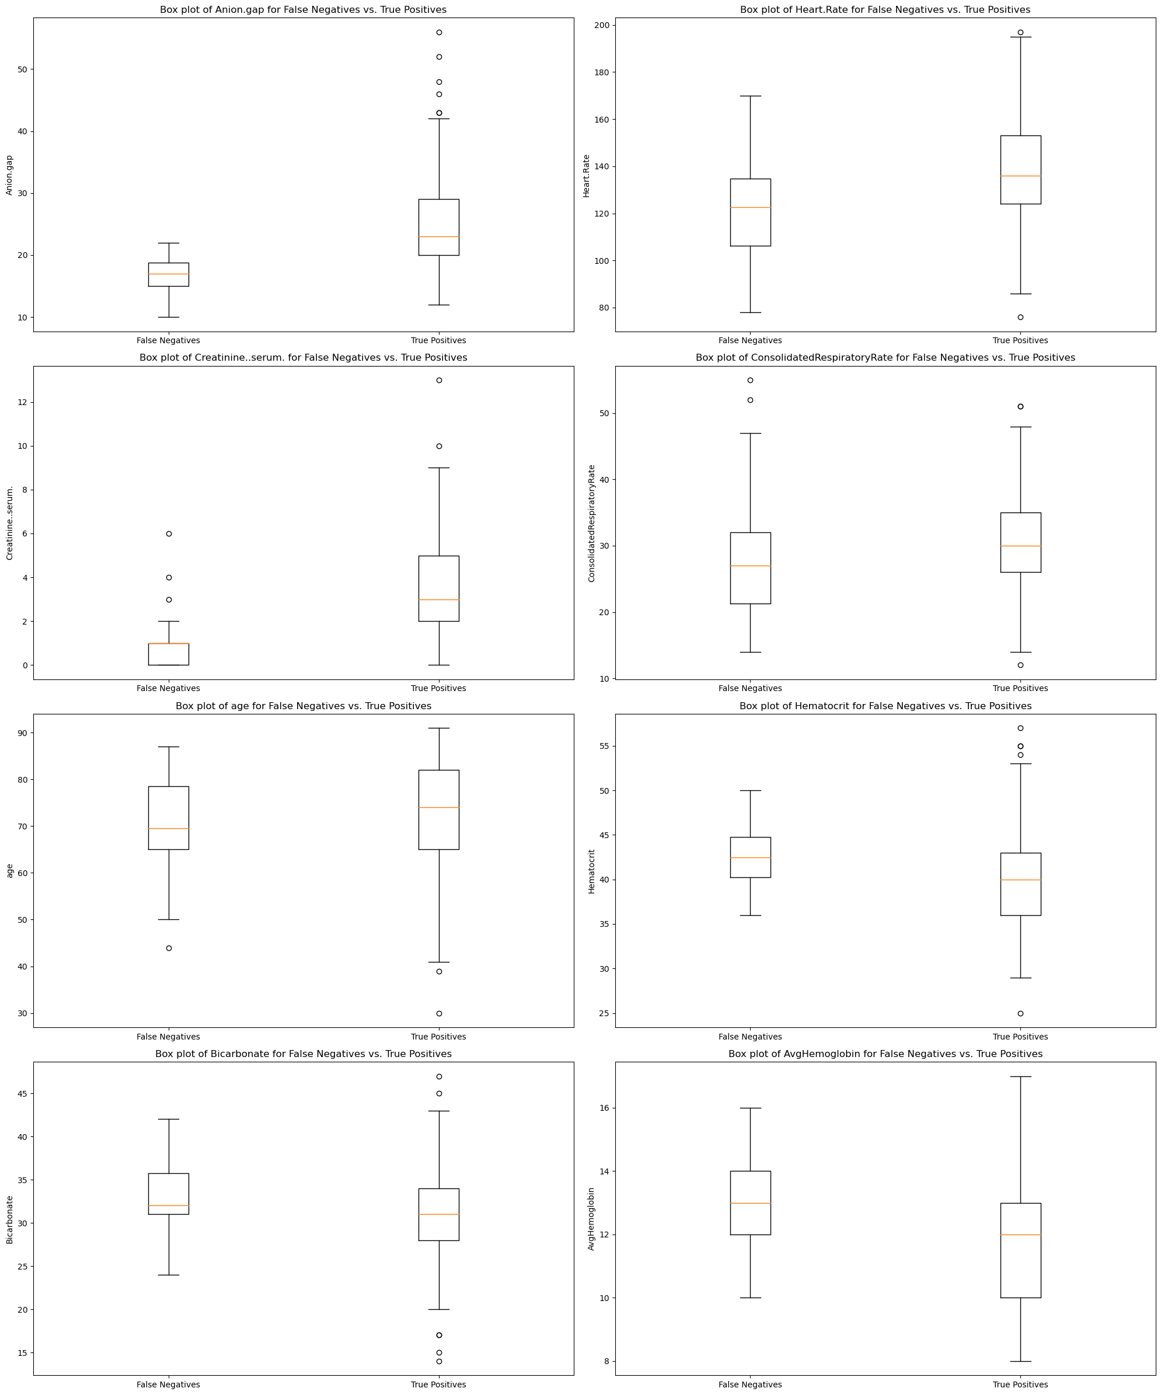
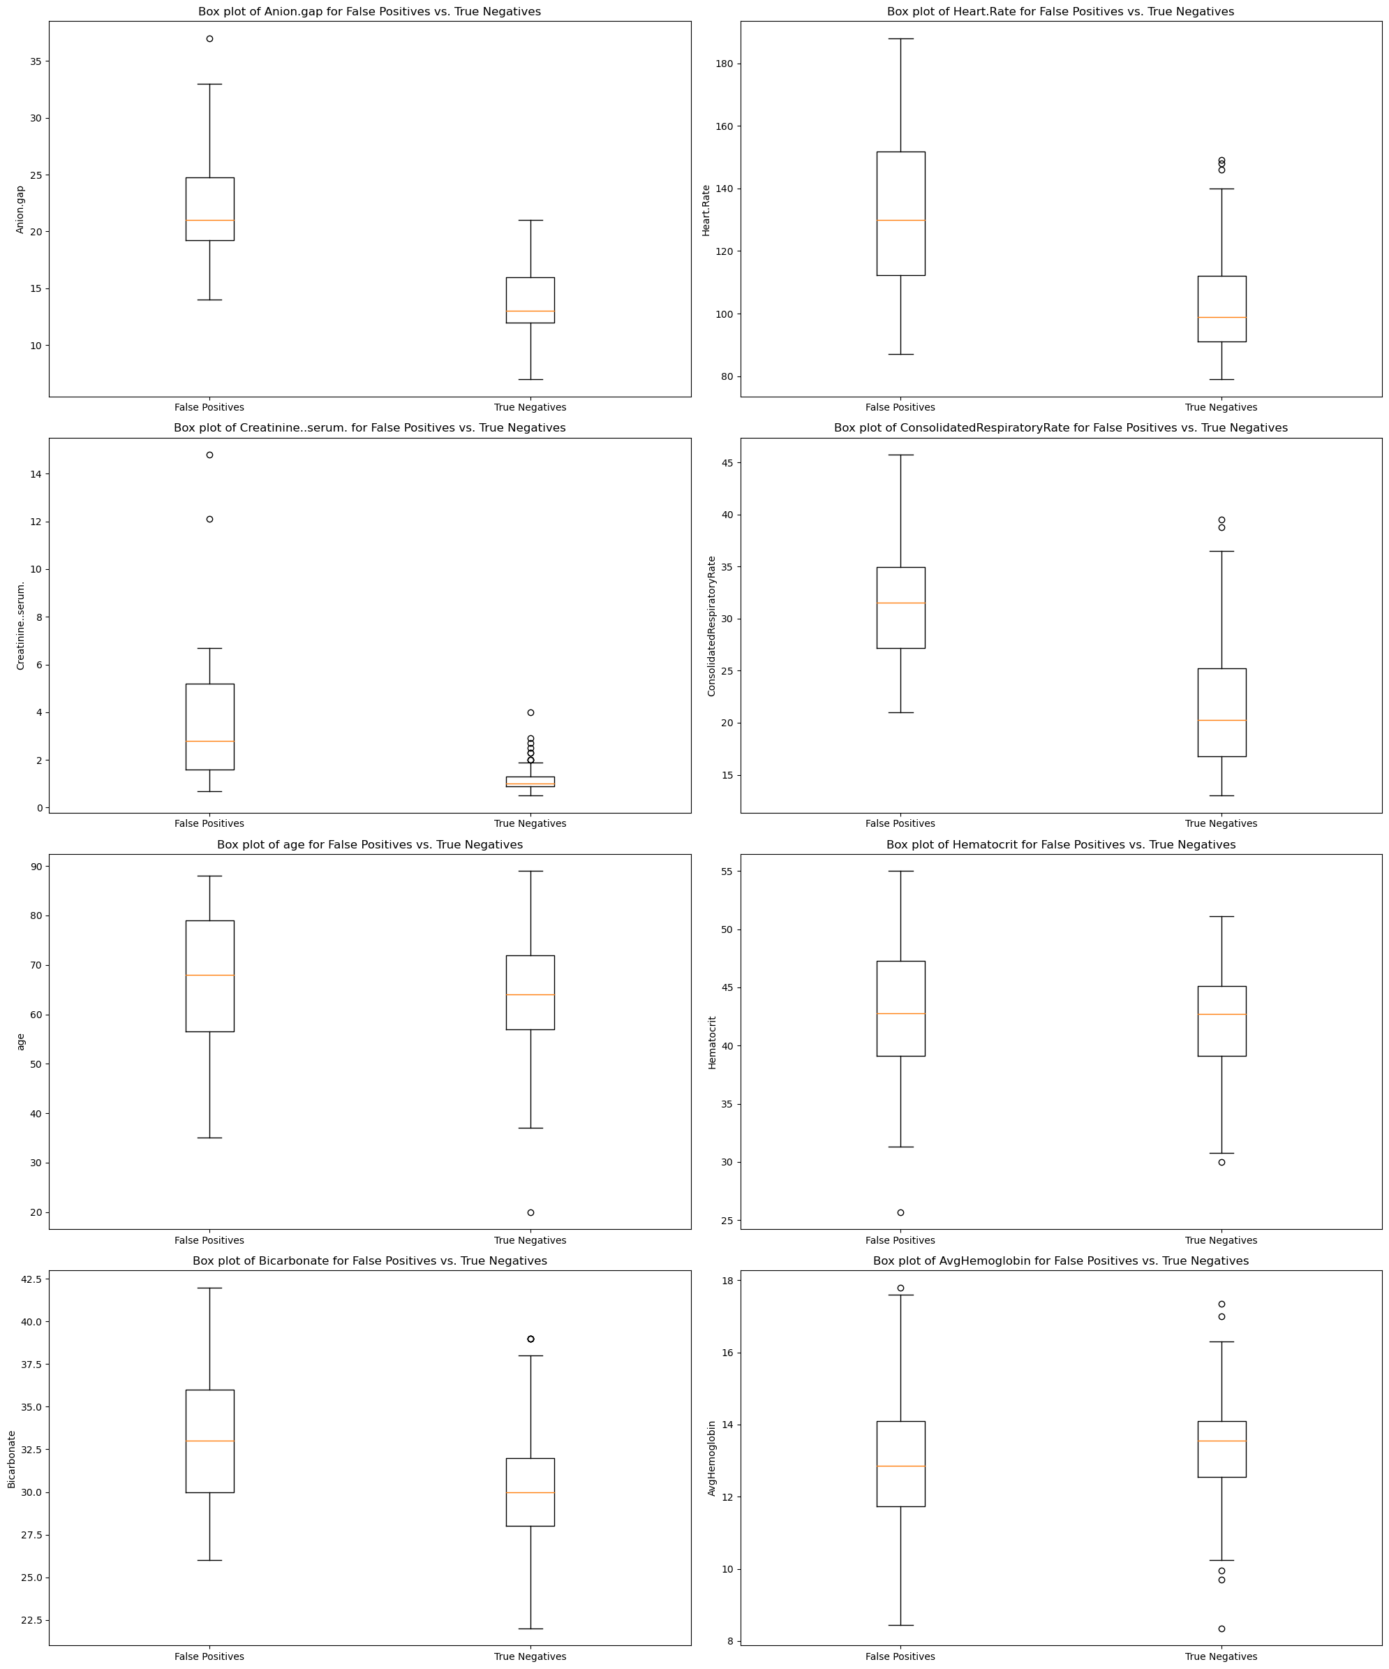
Error Analysis Continuation using RF model...
Then, we did compare the feature distribution of false positives comparing with true negatives and false negatives comparing with true positives using boxplots to identify the equality of variance of features. Also, we performed the Levene's test to assess the equality of variance in a set of sample. The null hypothesis of Levene's test is that the variances are equal across all groups. A low p-value (typically less than 0.05) indicates that there is enough evidence to reject the null hypothesis, suggesting that the variances are significantly different between the groups. “ Levene Test For Equality of Variances. By NIST 2019”
Ex:- If the p-value from Levene's test for a particular feature is less than 0.05, it would suggest that the variance of that feature is significantly different between the "True Positives" and "False Negatives" groups.
False negatives vs True positives
False positives vs True Negatives
According to the Boxplot and Levene's p-value results for each numerical feature comparing the
True Positives and False Negatives - Anion.gap, Creatinine..serum., Hematocrit
False Positives and True Negatives - Anion.gap, Heart.Rate, Creatinine..serum., Hematocrit, Bicarbonate, AvgHemoglobin
features shows an unequal variance between the two groups. Therefore, we are going to apply T-test for the equal variance features and Welch T-test for the unequal variance features.

Slide 11
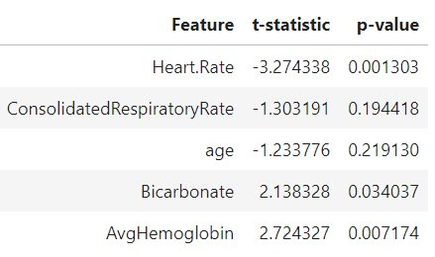
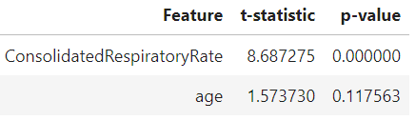
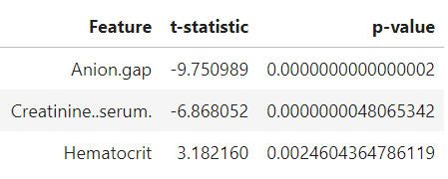
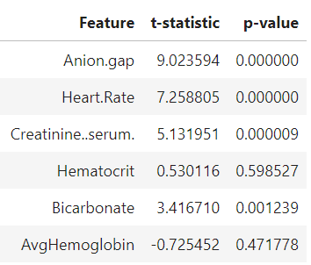
Error Analysis Continuation using RF model...
In the context of comparing two groups using t-tests, the null hypothesis (H0) states that there is no significant difference between the means of the two groups, while the alternative hypothesis (Ha) suggests that there is a significant difference between the means of the two groups.
Ex:- For the standard t-test applied to features with equal variances between false negatives and true positives:
Null Hypothesis (H0): The mean value of the feature is the same for false negatives and true positives.
Alternative Hypothesis (Ha): The mean value of the feature is different between false negatives and true positives.
For the Welch's t-test applied to features with unequal variances between false negatives and true positives:
Null Hypothesis (H0): The mean value of the feature is the same for false negatives and true positives.
Alternative Hypothesis (Ha): The mean value of the feature is different between false negatives and true positives.
False Negatives vs True Positives | False Positives vs True Negatives
 | Standard T-test
Welch T-test
Based on the result, the main factors contributing to
False Negatives - Anion.gap, Creatinine..serum., Hematocrit, Heart Rate, AvgHemoglobin and Bicarbonate.
False Positives - Anion.gap, Heart.Rate, RespiratoryRate, Creatinine..serum. and Bicarbonate
After that, we created plots comparing the distribution of the selected features between two groups: False negatives vs True positives and False Positives vs True Negatives. These plots are useful to understand how the selected features behave differently between the groups, which can provide insights into factors contributing to classification errors in the model.

Slide 12
Error Analysis Continuation using RF model...
Therefore, with the statistical test results we can conclude that the factors contributing to the,
False Negatives: Anion.gap, Creatinine..serum., Hematocrit, Heart Rate, AvgHemoglobin and Bicarbonate
False Positives: Anion.gap, Heart.Rate, RespiratoryRate, Creatinine..serum. and Bicarbonate
The common features/factors contribute to the false negatives and false positives are Anion.gap, Creatinine..serum., Heart.Rate and Bicarbonate. And the other individual factors contribute to result error predictions are Hematocrit, Hemoglobin and Respiratory rate. Also, we can conclude that most important features for model prediction are the ones that results error predictions in this case.
Common cases that machine learning models often misclassify as false positives or false negatives:
False Positives:
- Outliers: Data points that are far from most of the data.
- Noisy data: Data with errors or inconsistencies.
- Overlapping classes: When classes in the data are not well-separated, leading to misclassifications near the decision boundary.
- Imbalanced classes: When one class significantly outnumbers the other, leading to bias towards the majority class.
2. False Negatives:
- Imbalanced classes: Like false positives, imbalanced classes can lead to misclassification of the minority class.
- Insufficient features: When important features that distinguish classes are missing or not included in the model.
- Small sample size: When the number of instances for a particular class is too small for the model to learn effectively.
- Noisy data: Like false positives, noisy data can lead to misclassification.
In our case referring to the plots and diagrams, we can conclude that most of the classification errors were happens because of out-of-range values and inconsistent data in the important features.

Slide 13
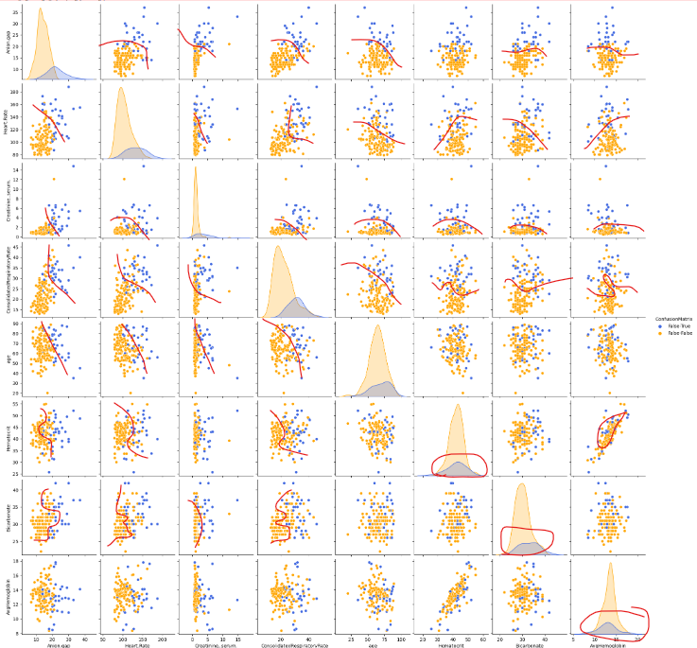
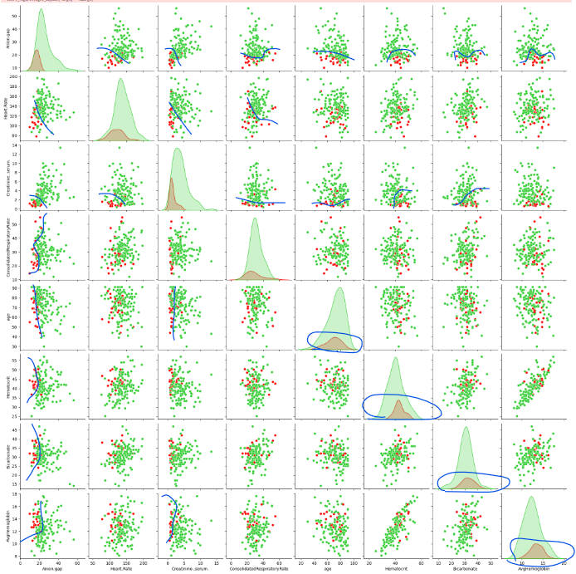
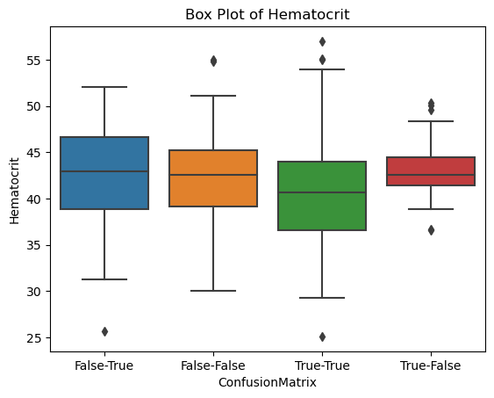
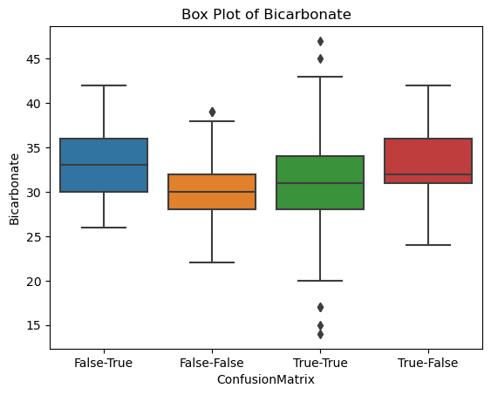
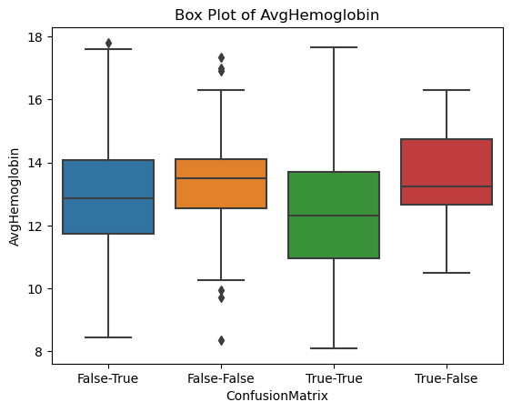
RF: What factors contribute to the occurrence of false positives? And false negatives?
To see clearly separation of we must check false-positive (False-True) and false negatives (False-False).
On the other hand separation of we must check false-negatives (True-False) and false negatives (True-True).
In the chart, with a red and blue line, we can see where variable observations are separate. Now, for:
Hematocrit.
AvgHemoglobin.
Bicarbonat.
After classifying the most important features, the subsequent features begin to overlap, which complicates the model's ability to avoid misclassifications.
This blending of colors in scatter plots, along with the closer mean of density distributions, is evident in box plots and indicates the challenge for the model.

Slide 14
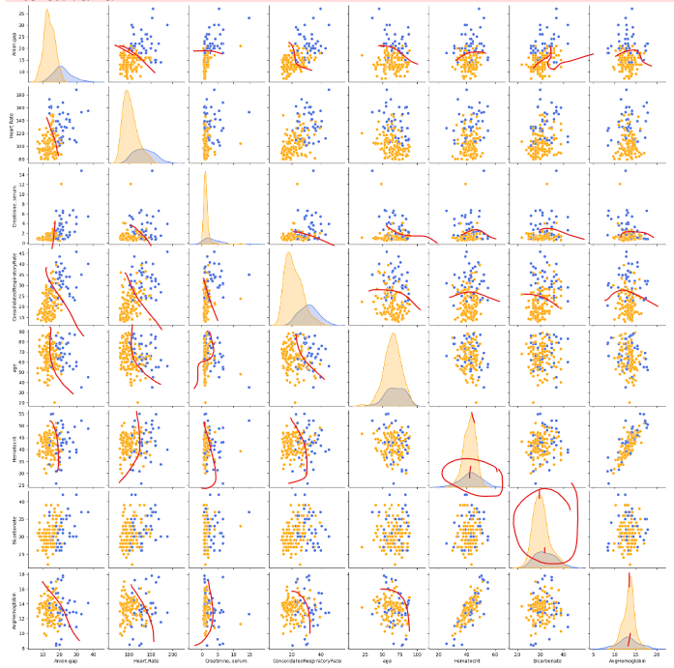
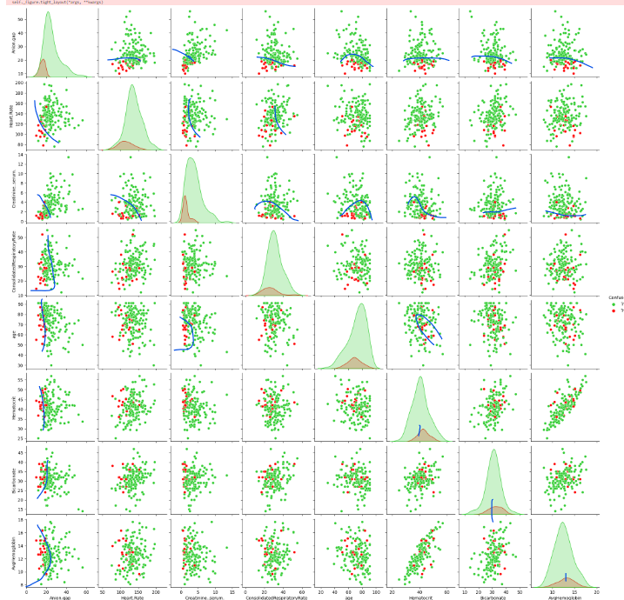
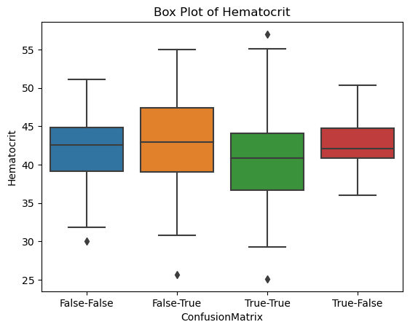
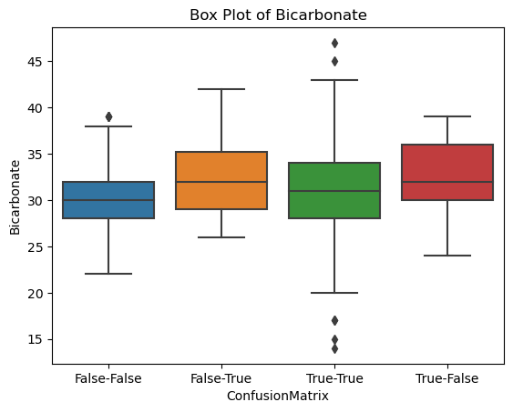
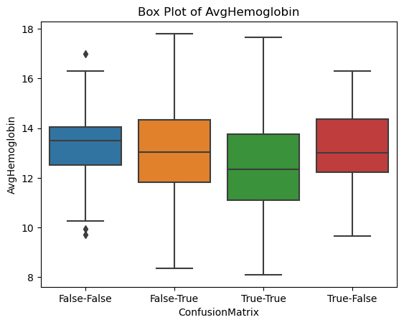
SVM: What factors contribute to the occurrence of false positives? And false negatives?
To confirm the Random Forest (RF) results, the same exercise was conducted with Support Vector Machine (SVM), producing consistent findings.
To clearly observe the separation, we need to examine false-positives (False-True) and false-negatives (False-False).
On the other hand, to assess the separation, we need to evaluate false-negatives (True-False) and false-positives (True-True).
In the chart, marked by red and blue lines, we can visualize where observations of variables are distinct. Focusing on:
Hematocrit.
AvgHemoglobin.
Bicarbonate.
After classifying the most important features, the reimaging features begin to overlap, making it tougher for the model to avoid mistakes in classification.
This blending of colors in scatter plots, along with the closer mean of density distributions, is clearly shown in box plots, indicating the challenge for the model.

Slide 15
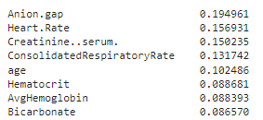
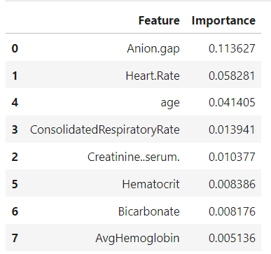
RF and SVM common errors analysis
RF important features
After testing models with similar features, we found that some features are more important than others for accurate classification. But three of these important features make it hard for the models to classify correctly.
Once we ignore the clearest classifications based on the most important features, it gets harder to tell how the models are classifying things.
Also, when there are unusual values in the important features, it makes it even trickier for the models to figure out the right classification.
SVM important features

Slide 16
Conclusions
An appropriate method for feature selection will generate a marginal lose in model performance.
RF and SVM prioritize variables differently, SVM prefers discrete values.
Outliers in most important features generate classification errors for least important variables.

Slide 17
References
Ruuska, Salla, Wilhelmiina Hämäläinen, Sari Kajava, Mikaela Mughal, Pekka Matilainen, and Jaakko Mononen. 2018. “Evaluation of the Confusion Matrix Method in the Validation of an Automated System for Measuring Feeding Behaviour of Cattle.” Behavioural Processes 148 (March): 56–62. doi:10.1016/j.beproc.2018.01.004.
“1.3.5.10. Levene Test For Equality of Variances,” n.d., https://www.itl.nist.gov/div898/handbook/eda/section3/eda35a.htm#:~:text=Levene's%20test%20(%20Levene%201960)%20is,used%20to%20verify%20that%20assumption.).

